Slide 1
Calculator Web Application
Presented by Divya Natesh , Mukund.G , Swapna Damodaran

Slide 2
Contents
Introduction
Basic Architecture
Timeline
Calculators
Authentication Methods
Issue Faced
New concepts understood
24-04-2023
Calculator Web Application

Slide 3
Technologies used
Spring Boot
Dependencies
MySQL
Angular
Google Oauth API
24-04-2023
Calculator Web Application

Slide 4
Timeline
5-10
- Migrating our Calculators from Core Java to Spring boot
11-13
- Integrating all the three Calculators on Spring Boot
13-17
- Implementing UI Components
17-20
- Work begins on authentication
- Completing Authentication Methods
- Integrating Authentication to the Frontend
- Improving the design for a better UX
- Revamping the design
24-04-2023
Calculator Web Application

Slide 5
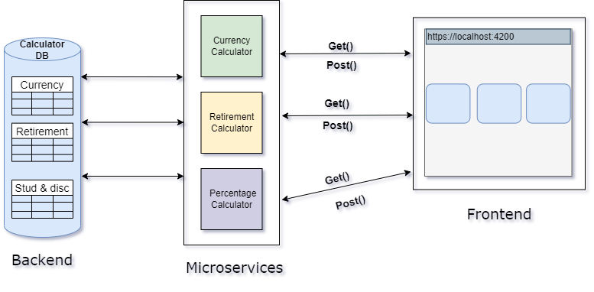
Basic Architecture
24-04-2023
Calculator Web Application

Slide 6
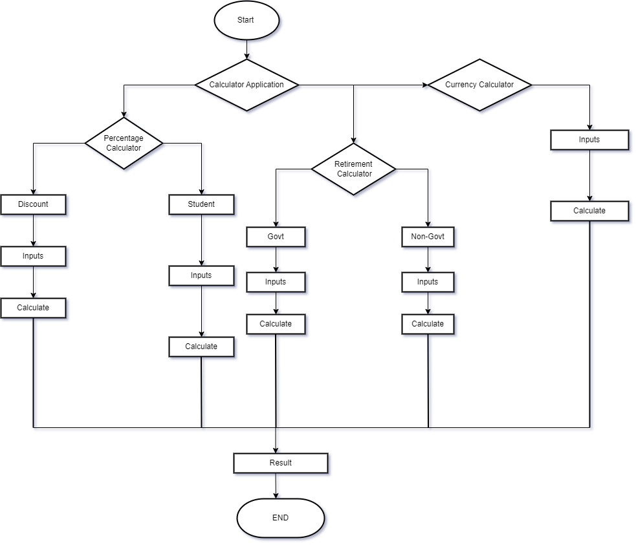
Flowchart
24-04-2023
Calculator Web Application

Slide 7
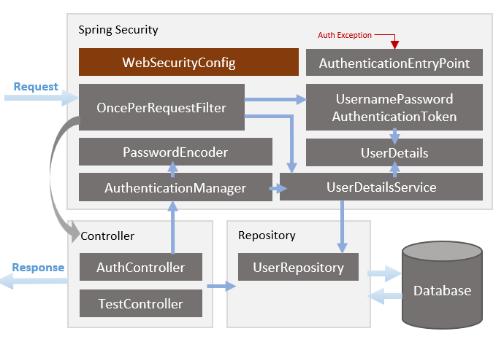
Authentication Architecture
24-04-2023
Calculator Web Application

Slide 8
What are the Issues we faced ?
UI Designing
Integration Issues
Calculated result Format Issues
Authentication issues
Mail authentication and Captcha authentication
24-04-2023
Calculator Web Application

Slide 9
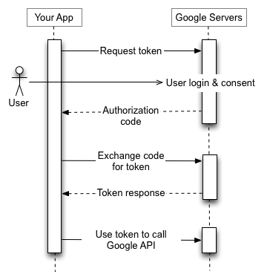
Authentication Methods Used
Registering User
Basic Authentication using Token verification
Google oAuth2 Login (Social Login)
Methods also tried
Mail OTP
ReCaptcha methods
Totp (Time Based OTP using any Authenticator )
Google Oauth2 Architecture
24-04-2023
Calculator Web Application

Slide 10
New Concepts Understood
Angular Material
Oauth2
Authentication
UI Designing
24-04-2023
Calculator Web Application

Slide 11
Thank you
24-04-2023
Calculator Web Application
Notes:
Thank them

